Slide 1
Introduction to Discrete Event Simulation Session 11
Arnold Buss
MOVES Institute
Naval Postgraduate School
Monterey, CA 93943

Slide 2
Overview
(Pseudo) Random Number Generation
Random Variate Generation

Slide 3
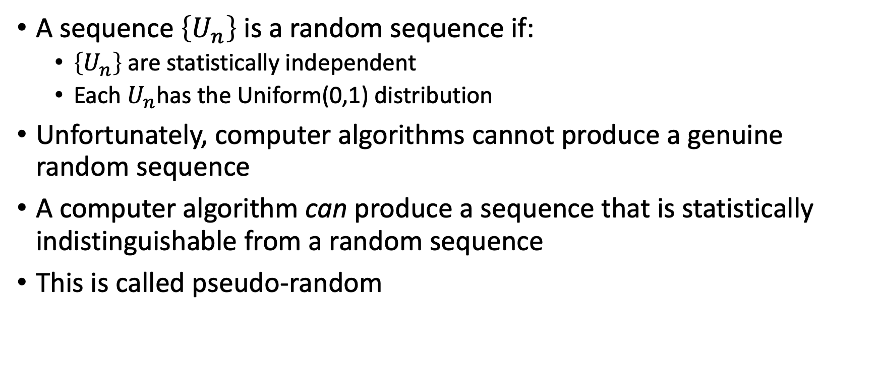
(Pseudo) Random Number Generation
A sequence $\left\{U_{n}\right\}$ is a random sequence if:
$\left\{U_{n}\right\}$ are statistically independent
Each $U_{n}$has the Uniform(0,1) distribution
Unfortunately, computer algorithms cannot produce a genuine random sequence
A computer algorithm can produce a sequence that is statistically indistinguishable from a random sequence
This is called pseudo-random

Slide 4
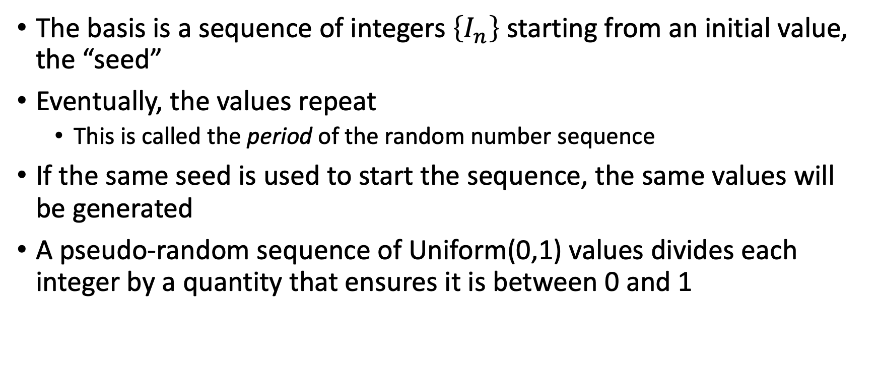
How a Pseudo Random Number Generator Works
The basis is a sequence of integers $\left\{I_{n}\right\}$ starting from an initial value, the “seed”
Eventually, the values repeat
This is called the period of the random number sequence
If the same seed is used to start the sequence, the same values will be generated
A pseudo-random sequence of Uniform(0,1) values divides each integer by a quantity that ensures it is between 0 and 1

Slide 5
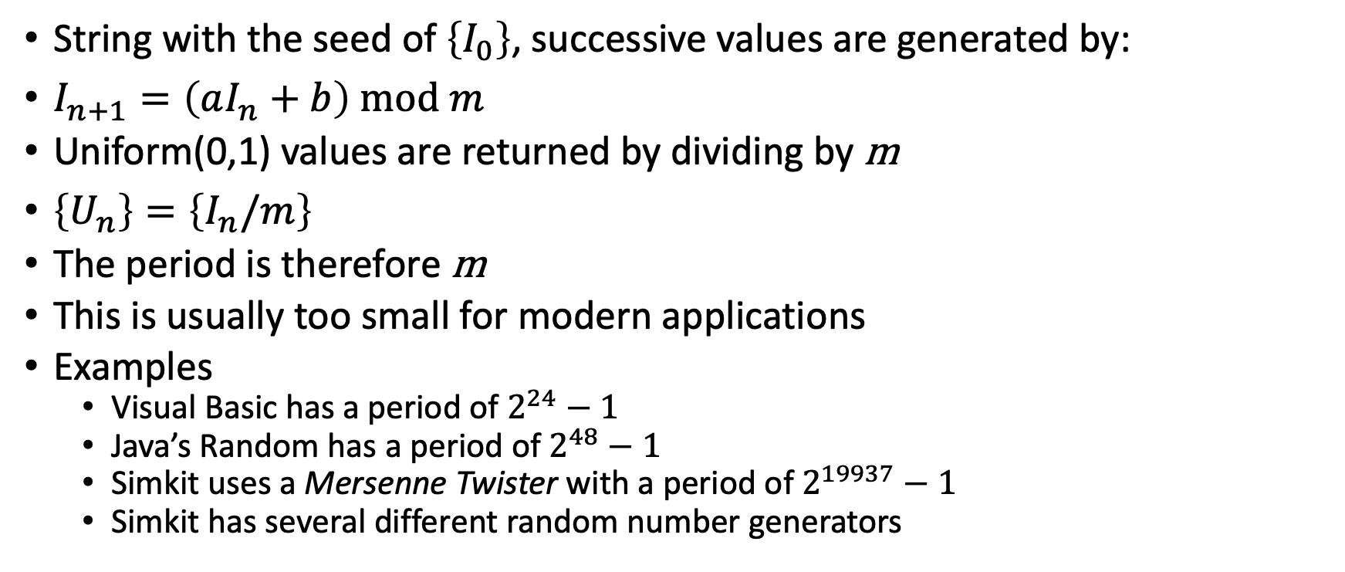
Example: Linear Congruential Generator
String with the seed of $\left\{I_{0}\right\}$, successive values are generated by:
$I_{n+1}=\left(aI_{n}+b\right) \text{mod} m$
Uniform(0,1) values are returned by dividing by m
$\left\{U_{n}\right\}=\left\{I_{n}/m\right\}$
The period is therefore m
This is usually too small for modern applications
Examples
Visual Basic has a period of $2^{24}−1$
Java’s Random has a period of $2^{48}−1$
Simkit uses a Mersenne Twister with a period of $2^{19937}−1$
Simkit has several different random number generators

Slide 6
Myths About the Seed
The system clock can be used to set the seed
This does not add any significant randomness in a simulation study
For situations where different states are needed for repeated play, it is ok
Example: a first-person shooter replaying a given room
Discrete Event Simulation models used for analysis have no need for a “random” seed

Slide 7
Recommendations
Avoid Visual Basic (and VBA) and Java’s random number generators for “production” analysis
Mersenne Twister is a good choice
All major languages have a version that can be used
Python actually uses the Mersenne Twister for its built-in generator

Slide 8
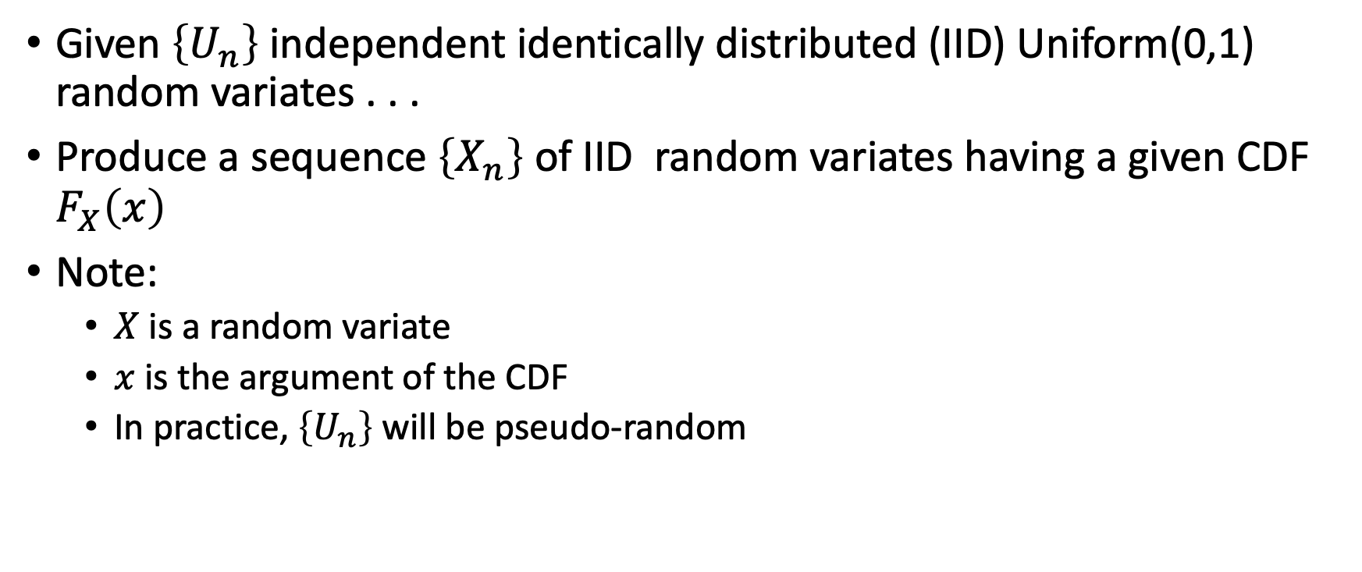
Random Variate Generation
Given $\left\{U_{n}\right\}$ independent identically distributed (IID) Uniform(0,1) random variates . . .
Produce a sequence $\left\{X_{n}\right\}$ of IID random variates having a given CDF $F_{X}\left(x\right)$
Note:
$X$ is a random variate
$x$ is the argument of the CDF
In practice, $\left\{U_{n}\right\}$ will be pseudo-random

Slide 9
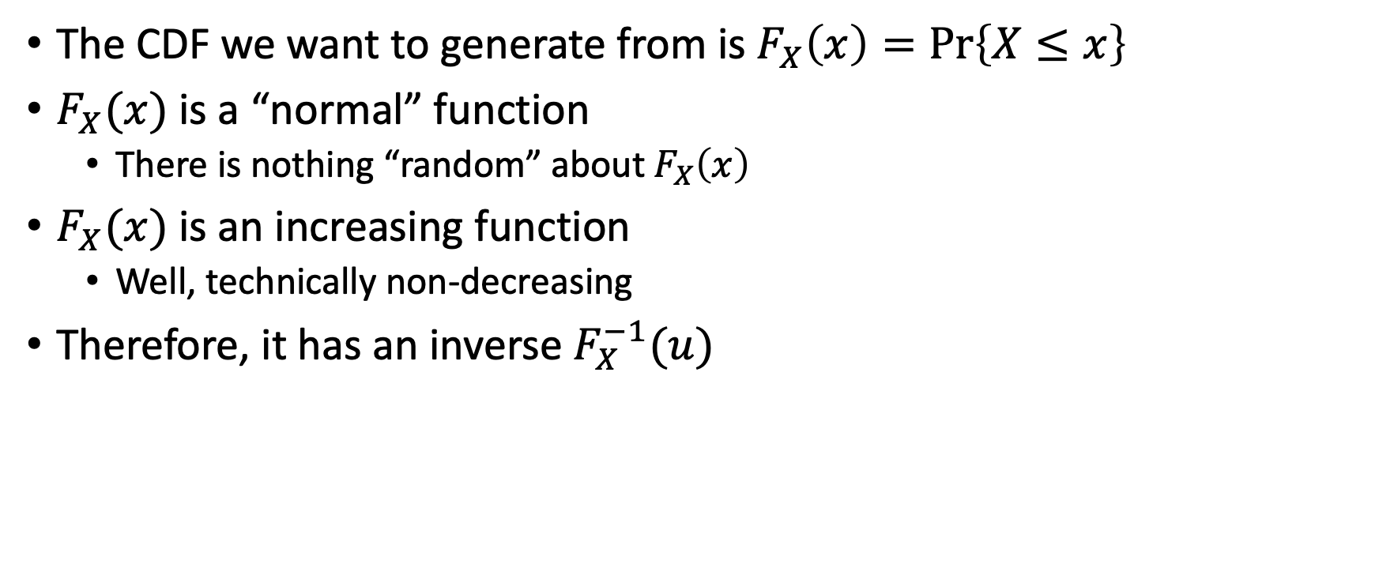
Inverse Transform Method
The CDF we want to generate from is $F_{X}\left(x\right)=\operatorname{Pr}\left\{X≤x\right\}$
$F_{X}(x)$ is a “normal” function
There is nothing “random” about $F_{X}\left(x\right)$
$F_{X}(x)$ is an increasing function
Well, technically non-decreasing
Therefore, it has an inverse $F_{X}^{−1}(u)$

Slide 10

Getting the Inverse of a Function
Set $u=F_{X}(x)$
Solve for $x=F_{X}^{−1}(u)$

Slide 11
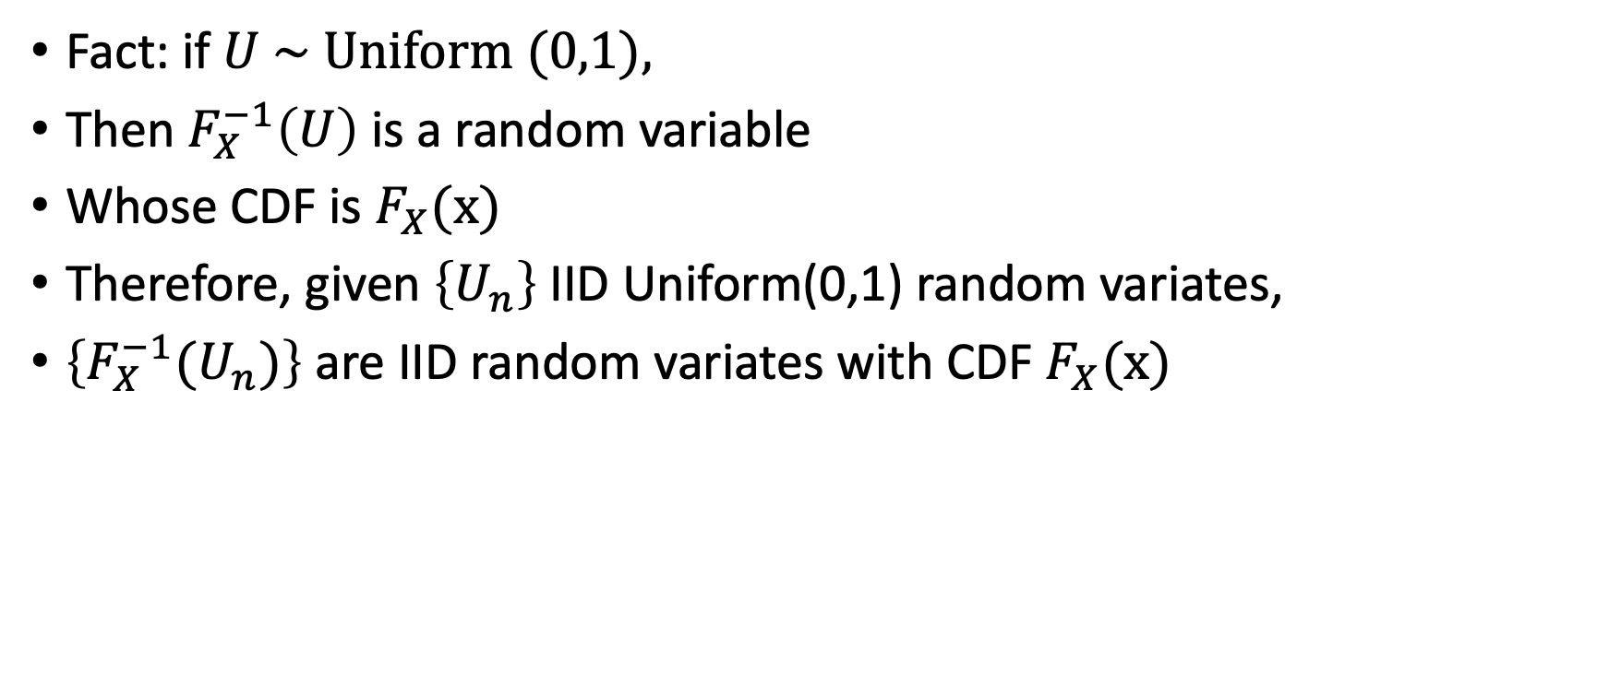
The Inverse Transform Method
Fact: if $U \sim \text{Uniform} (0,1),$
Then $F_{X}^{−1}\left(U\right)$ is a random variable
Whose CDF is $F_{X}(x)$
Therefore, given $\left\{U_{n}\right\}$ IID Uniform(0,1) random variates,
$\left\{{F_{X}^{−1}(U}_{n})\right\}$ are IID random variates with CDF $F_{X}(x)$

Slide 12
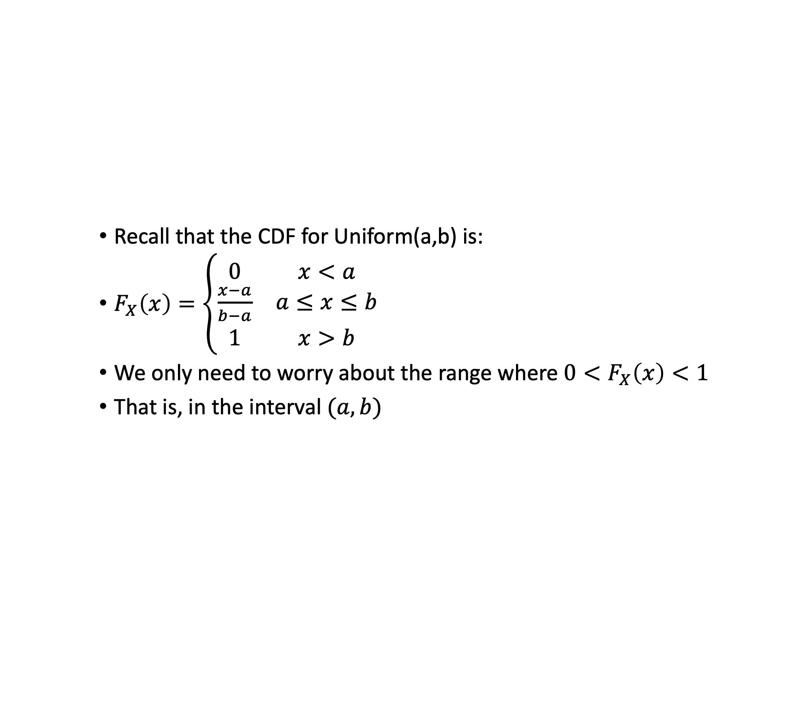
Example: Uniform(a,b)
Recall that the CDF for Uniform(a,b) is:
$F_{X}\left(x\right)=\left\{\begin{matrix}0 & x<a \\ \frac{x−a}{b−a} & a≤x≤b \\ 1 & x>b\end{matrix}\right.$
We only need to worry about the range where ${0<F}_{X}\left(x\right)<1$
That is, in the interval $(a,b)$

Slide 13
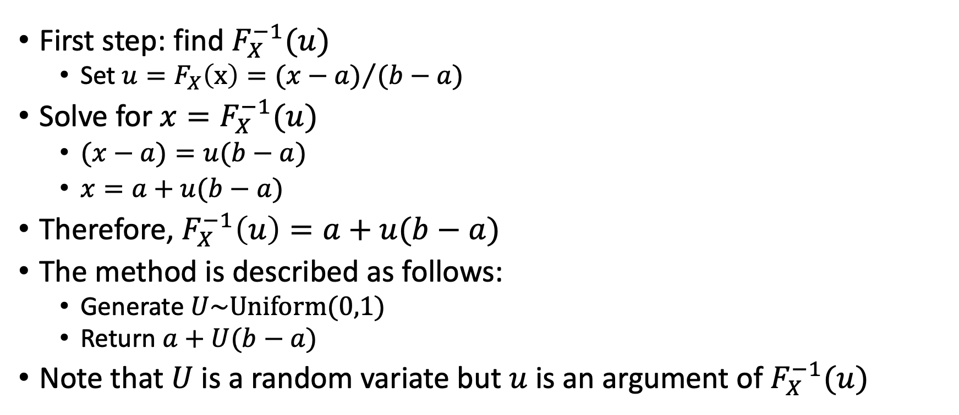
Uniform(a,b) (cont)
First step: find $F_{X}^{−1}(u)$
Set $u=F_{X}\left(x\right)={(x−a)}/{(b−a)}$
Solve for $x=F_{X}^{−1}(u)$
$(x−a)=u(b−a)$
$x=a+u(b−a)$
Therefore, $F_{X}^{−1}\left(u\right)=a+u(b−a)$
The method is described as follows:
Generate $U\sim \text{Uniform}(0,1)$
Return $a+U(b−a)$
Note that $U$ is a random variate but $u$ is an argument of $F_{X}^{−1}(u)$

Slide 14
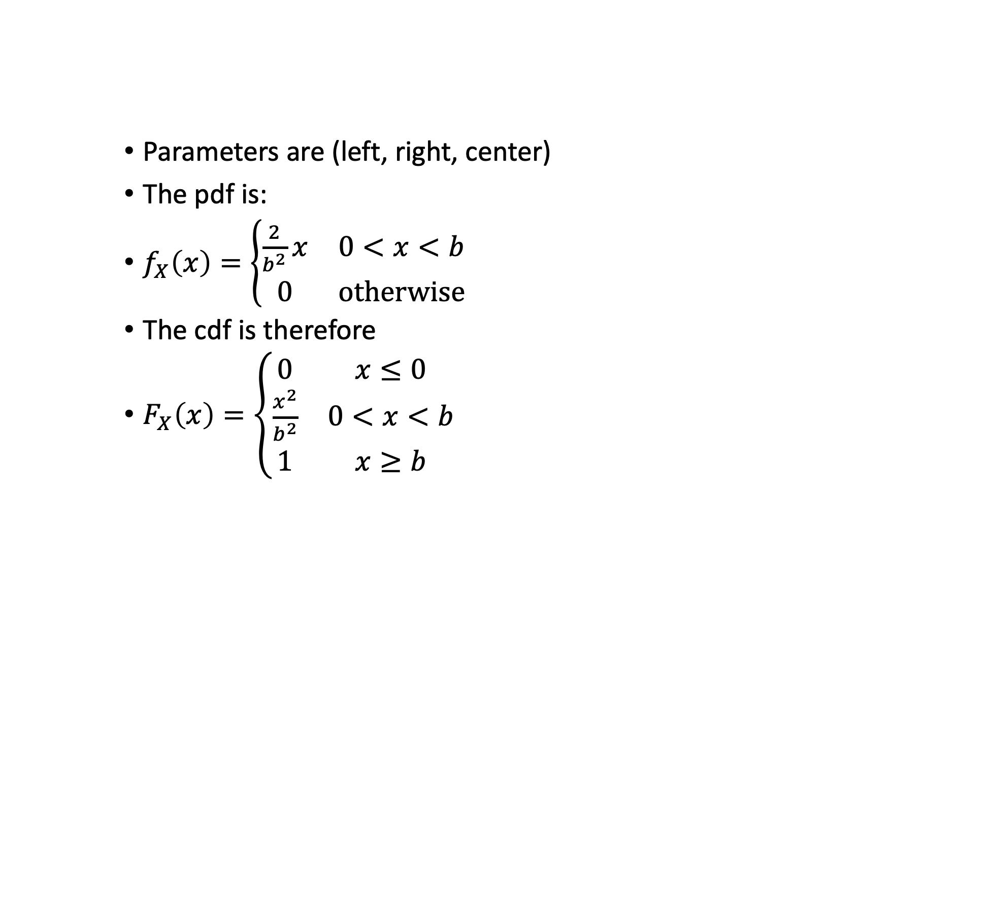
Triangle(0,b,b)
Parameters are (left, right, center)
The pdf is:
$f_{X}\left(x\right)=\left\{\begin{matrix}\frac{2}{b^{2}}x & 0<x<b \\ 0 & \text{otherwise}\end{matrix}\right.$
The cdf is therefore
$F_{X}\left(x\right)=\left\{\begin{matrix}0 & x≤0 \\ \frac{x^{2}}{b^{2}} & 0<x<b \\ 1 & x≥b\end{matrix}\right.$

Slide 15
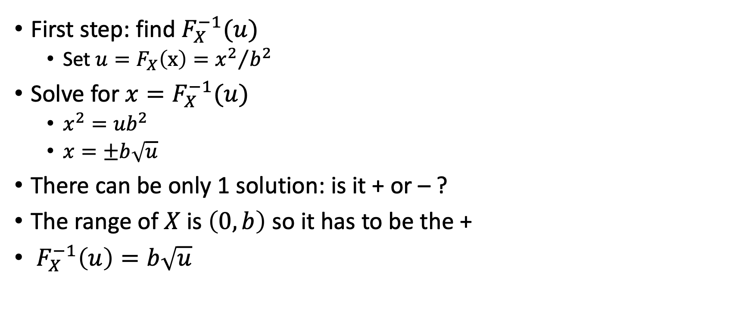
Triangle(0,b,b) (cont)
First step: find $F_{X}^{−1}(u)$
Set $u=F_{X}\left(x\right)={x^{2}}/{b^{2}}$
Solve for $x=F_{X}^{−1}(u)$
$x^{2}={ub}^{2}$
$x=±b\sqrt{u}$
There can be only 1 solution: is it + or – ?
The range of $X$ is $\left(0,b\right)$ so it has to be the +
$F_{X}^{−1}\left(u\right)=b\sqrt{u}$

Slide 16

Triangle(0,b,b) Method
Generate $U\sim \text{Uniform}(0,1)$
Return $b\sqrt{U}$

